Slide 1






The consumption of fish in the prevention of obesity
Prof. Angel Gil
Department of Biochemistry and Molecular Biology II, Institute of Nutrition & Food Technology “José Mataix”, Biomedical Research Center, University of Granada, CIBEROBN, Spain
President of the Iberoamerican Nutrition Foundation (FINUT)

Slide 2

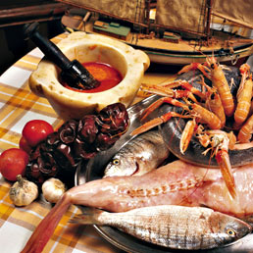

FISH, AN IMPORTANT SOURCE OF NUTRIENTS
Fish is an important source of energy, high-quality proteins, fat, vitamins and minerals.
Within lipids, n-3 long-chain PUFA (n-3 LC PUFA), mainly EPA and DHA, play an important role in health promotion and disease prevention

Slide 3
BENEFITS OF FISH CONSUMPTION
The health attributes of fish are most likely due in large part to n-3 LC-PUFAs.
Fish contain other nutrients (e.g. protein, selenium, iodine, vitamin D, choline and taurine) that may also contribute to the health benefits of fish.
The health effects of fish consumption may be greater than the sum of its individual constituents.
Eating fish is also part of the cultural traditions of many peoples. In some countries, where viable options for substitute foods are extremely limited, fish is the major source of protein and other essential nutrients.
Gil A, Gil F. Benefits vs risks of fihs intake. Br J Nutr 2015

Slide 4
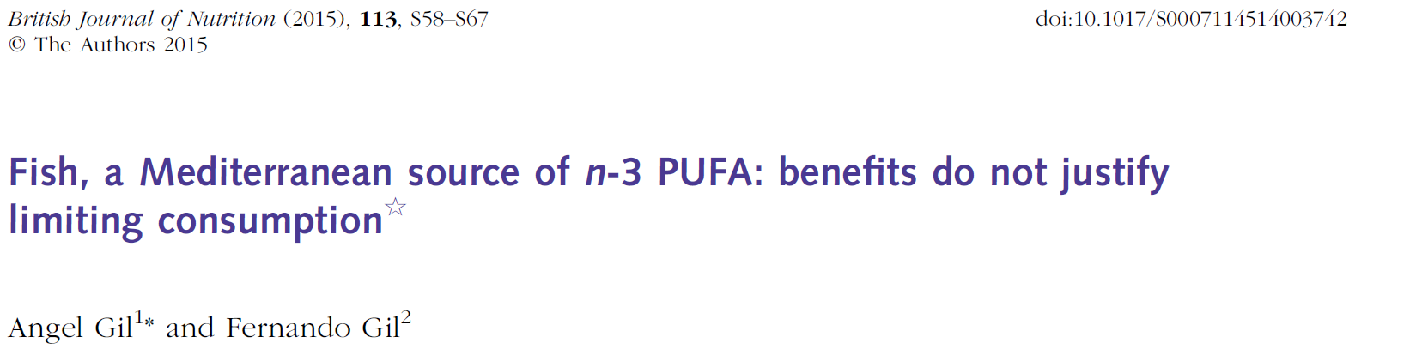
For major health outcomes among adults, the vast majority of epidemiological studies have proven that the benefits of fish intake exceed the potential risks with the exception of a few selected species in sensitive populations

Slide 5
HOW DOES FISH CONSUMPTION AFFECT BODY WEIGHT AND OBESITY AND ITS COMORBIDITIES?

Slide 6
THE GLOBAL BURDEN OF OBESITY
Exces bodyweight and obesity is the 6th most important risk factor contributing to the overal burden of disease worlwide
2,100 millions of adults are overweight of which 640 millions are obese
110 millions of children classified as overweight or obese worlwide
Obesity predisposes to an increased risk of developing many diseases:
Metabolic syndrome
Atherosclerosis
Type 2 diabetes
Non-alcoholic fatty liver disease
Cancer
Immune-mediated diseases (Asthma)
Sleep apnea
Bone fractures

Slide 7

GLOBAL PREVALENCE OF OBESITY ACCORDING TO COUNTRY
The GBD 2015 Obesity Collaborators. N Engl J Med 2017;377:13-27.

Slide 8
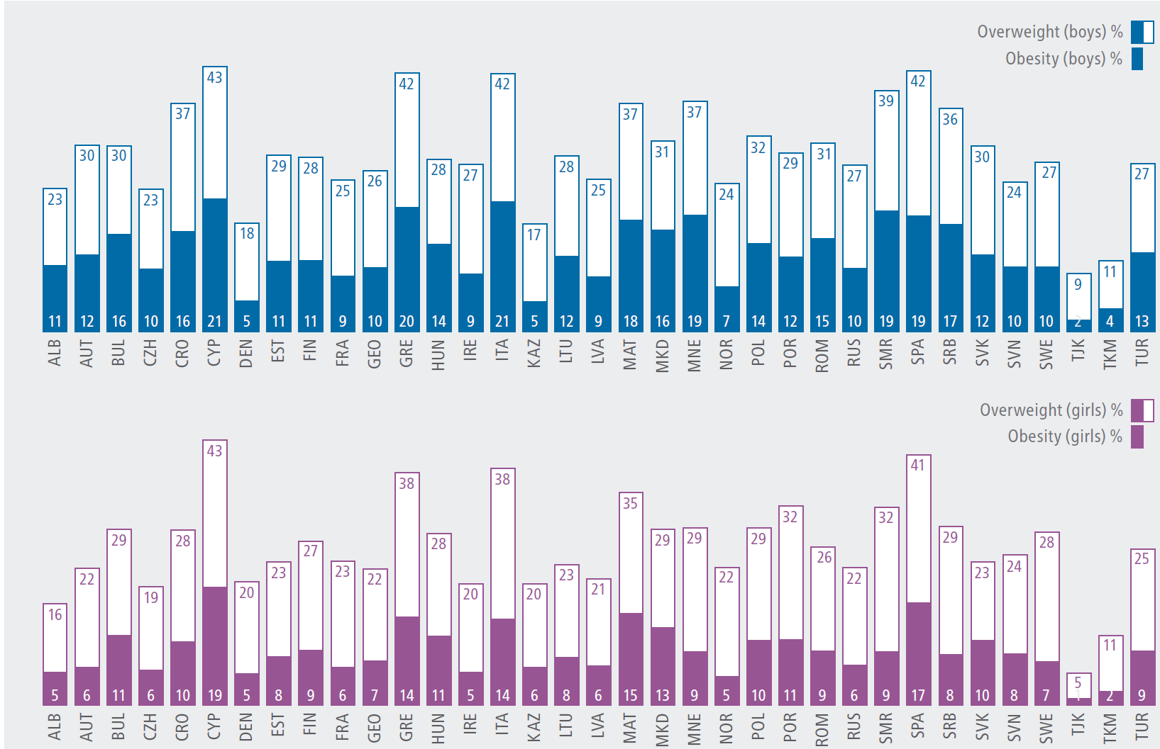
OVERWEIGHT AND OBESITY PREVALENCE AMONG EUROPEAN CHILDREN AGED 6-9 YEARS
COSI © WHO 2016 CHILDHOOD OBESITY SURVEILLANCE INITIATIVE, June 2018

Slide 9
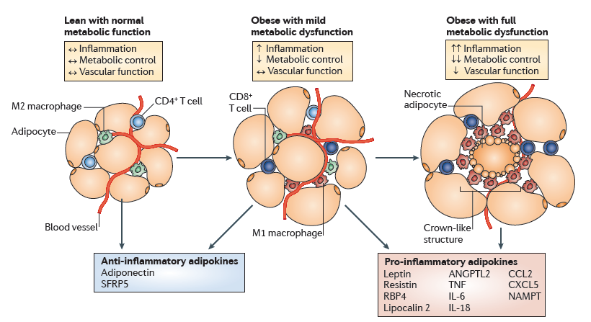
PHENOTYPE MODULATION OF WHITE ADIPOCYTES IN OBESITY
Ouchi et al. Nat Review . Published online 21 January 2011 doi:10.1038/nri2921

Slide 10
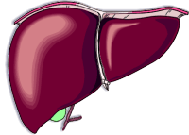
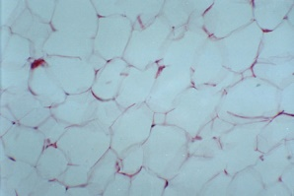
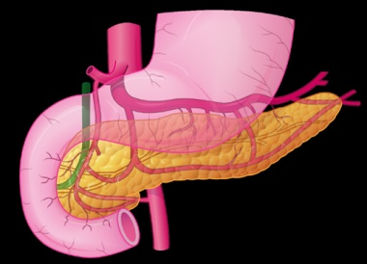
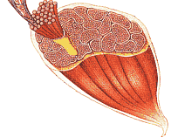
THE PORTAL THEORY OF INSULIN RESISTANCE
DYSLIPOPROTEINEMIA
↓HDL-chol
↑Triglycerides
↑Dense LDL
↑Gluconeogenesis
INCREASED
ADIPOSITY
HYPERINSULINEMIA
HYPERGLYCAEMIA
↑FFA
LIPOTOXICITY (LC acyl-CoA)
HYPERINSULINEMIA
Compensatory
insulin release
Eventual β-cell failure
↑Insulin resistance
↓Glucose uptake
from circulation
↓Oxidative potential
Cañete R, Gil-Campos M, Aguilera CM, Gil A Eur J Nutr 2007; DOI 10.1007/s00394-007-0648-9

Slide 11
MAIN METABOLIC DISTURBANCES ASSOCIATED WITH OBESITY
METABOLIC SYNDROME
Visceral obesity
Insulin resistance
ADDITIONAL RISK FACTORS
Glucose intolerance
Dyslipidaemia
Hypertension
Microalbuminuria
Hyperuricaemia
Low-grade inflammation
Disturbed adipokine
secretion
Disturbances in haemolysis
and fibrinolysis

Slide 12
METABOLIC SYNDROME
Obesity
Impaired glucose metabolism
TAG
HDL-c
Blood Pressure

Slide 13
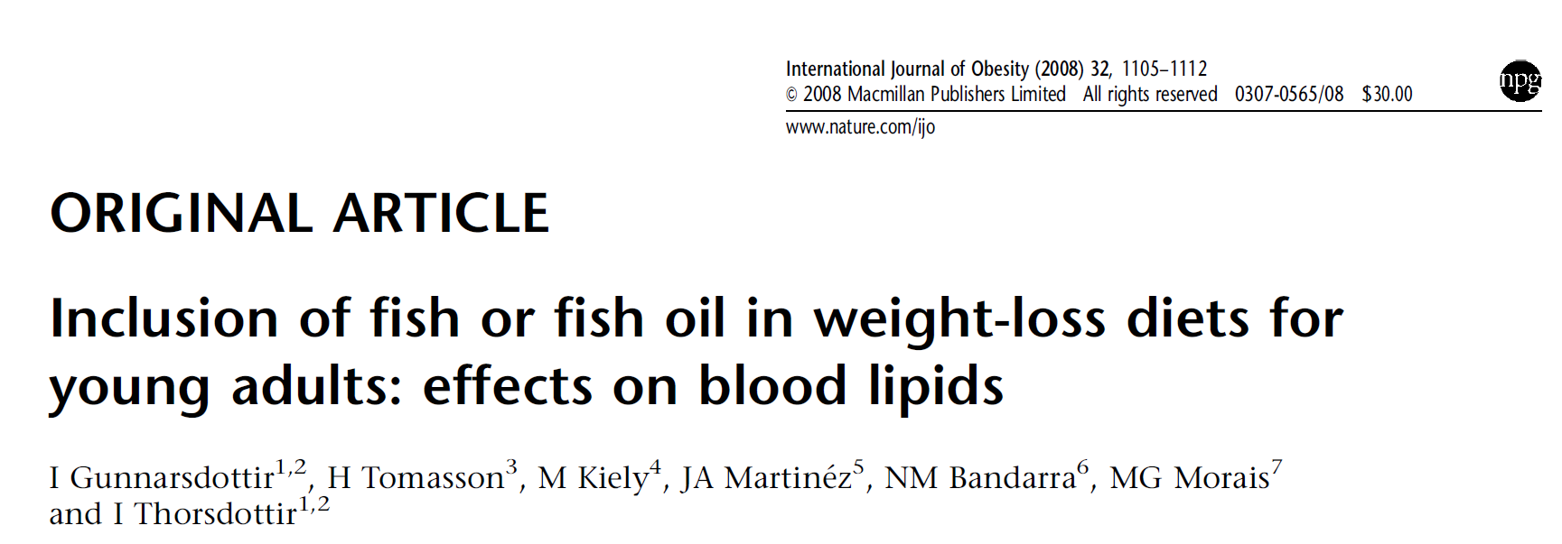
Oily fish incorporated to a weight-loss diet among young overweight or obese individuals resulted in greater reduction in TG concentration when compared with a group receiving diet without food of marine origin.
TG lowering effects of cod, in combination with relatively low amount of LC n-3 PUFAs, shown in this study might be of importance in understanding the health-related effects of fish.
Lowering of TC was also apparent in the groups receiving whole fish.
Interaction between LC n-3 PUFAs from fish, fish proteins or other nutrients found in fish might be of relevance

Slide 14
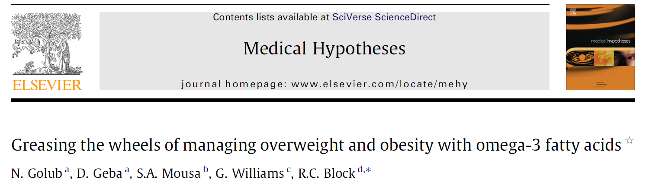
Hypothesis
EPA and DHA supplementation in populations can reduce the reward associated with food, thereby reduce appetite and food intake, and ultimately contribute to the prevention or reduction of obesity.

Slide 15
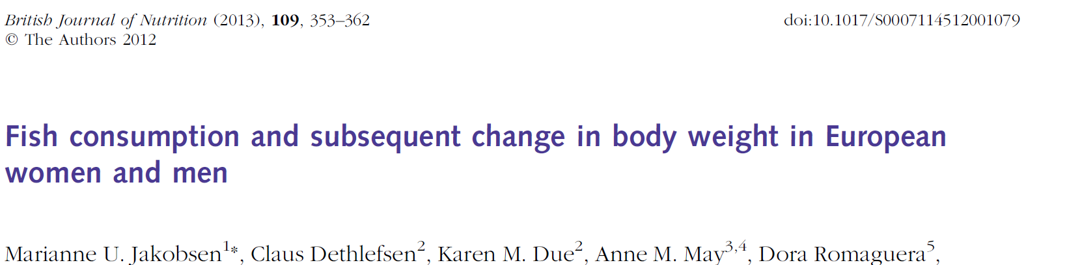
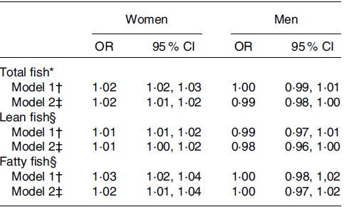
The present study (344,757 participants) suggests that fish consumption has no appreciable association with body-weight gain

Slide 16
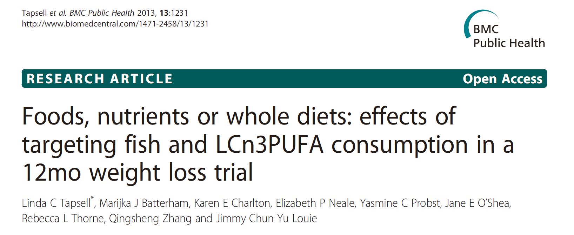
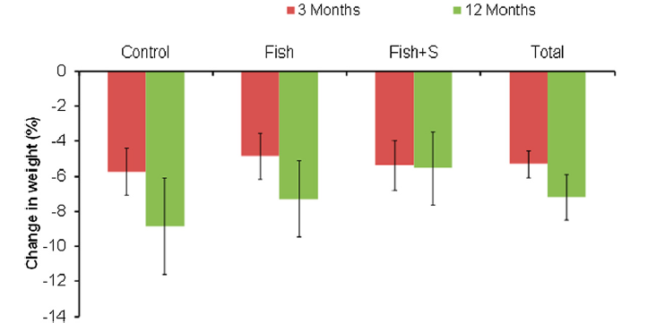
Advice to consume 2 fish meals per week did not appear to enhance the effects on weight loss of a healthy low calorie diet

Slide 17
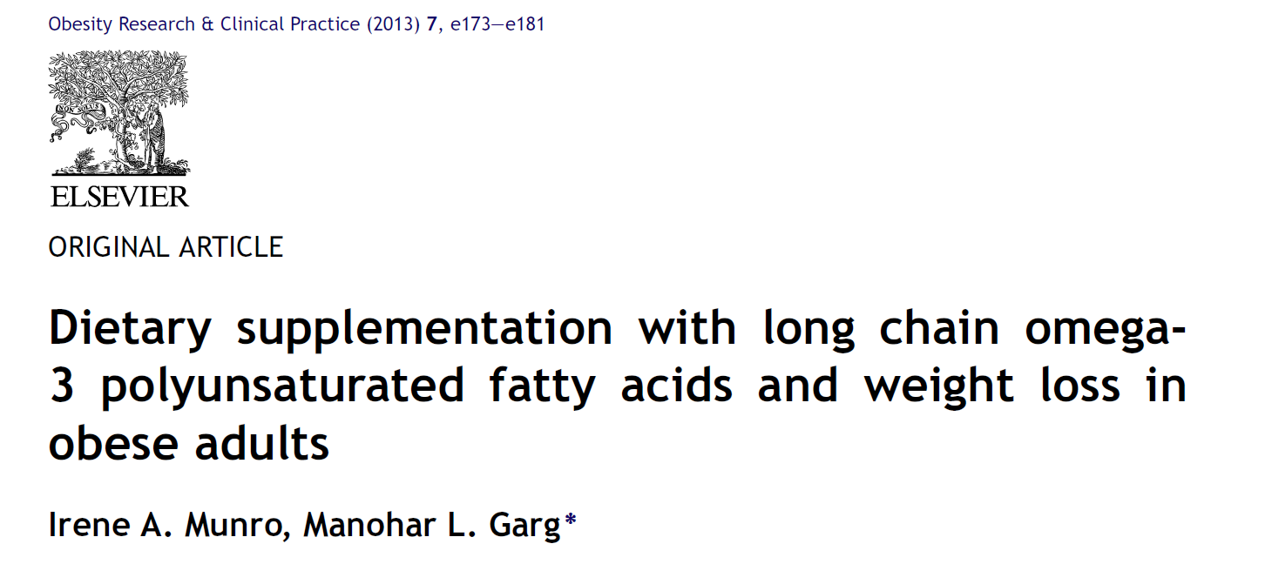
There were no significant difference within and between the placebo and the fish oil groups for weight reduction (3.37% and 4.35% respectively), fat mass reduction (8.95% and 9.76% respectively), or changes in inflammatory biomarkers and blood lipids apart from triglycerides, reduced by 27% in fish oil group (p < 0.05).

Slide 18
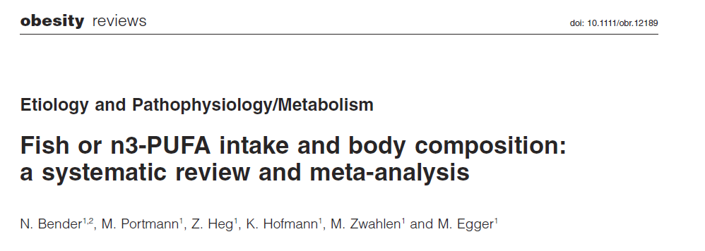
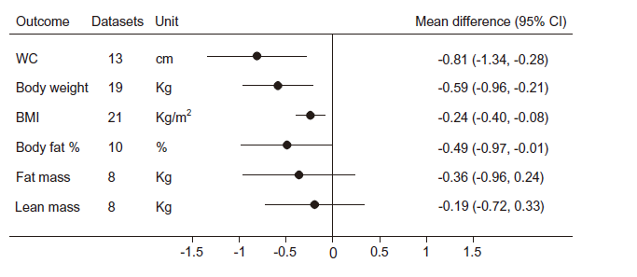
Bender et al. Obesity reviews (2014) 15, 657–665

Slide 19
Participants taking fish or fish oil lost 0.59 kg more body weight than controls.
Treatment groups lost 0.24 kgx m⁻² (body mass index) more than controls and 0.49% more body fat than controls.
Fish or fish oil reduced waist circumference by 0.81 cm compared with control.
There was no difference for fat mass and lean body mass.
Bender et al. Obesity reviews (2014) 15, 657–665

Slide 20
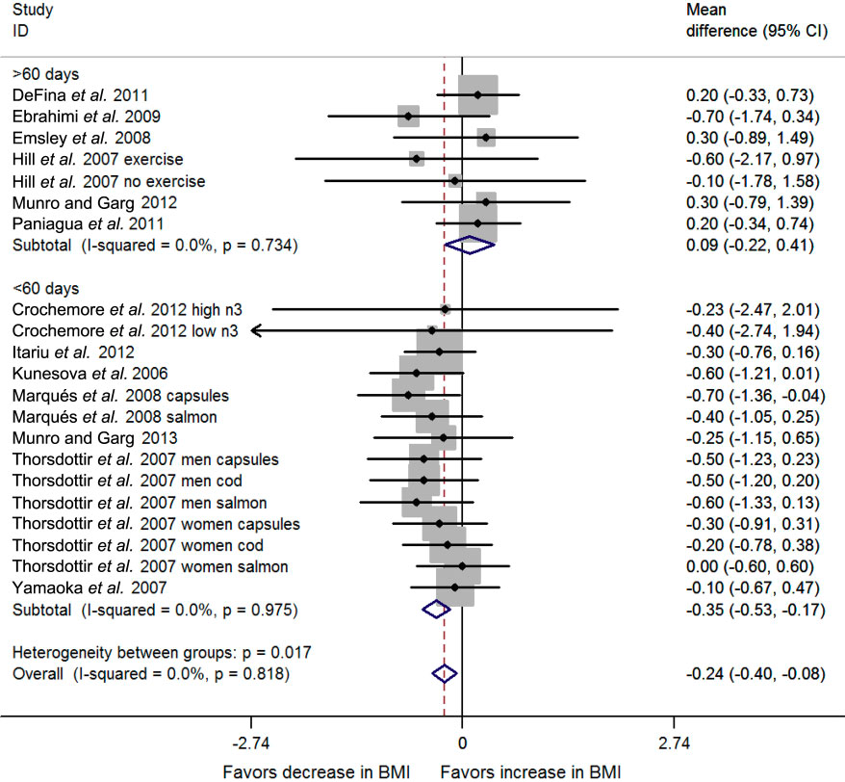
FOREST PLOT ON THE ASSOCIATION BETWEEN FISH OR FISH OIL AND BODY MASS INDEX (BMI), BY TIME OF STUDY DURATION.
Bender et al. Obesity reviews (2014) 15, 657–665

Slide 21
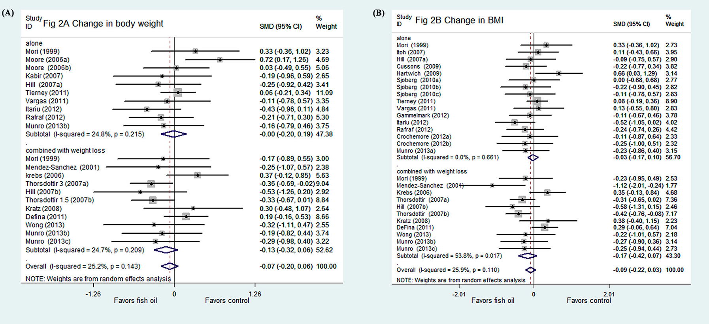
DOES FISH OIL HAVE AN ANTI-OBESITY EFFECT IN OVERWEIGHT/ OBESE ADULTS? A META-ANALYSIS OF RANDOMIZED CONTROLLED TRIALS.
Du S, Jin J, Fang W, Su Q PLoS ONE. 2015; 10(11): e0142652. doi:10.1371/journal.pone.0142652

Slide 22
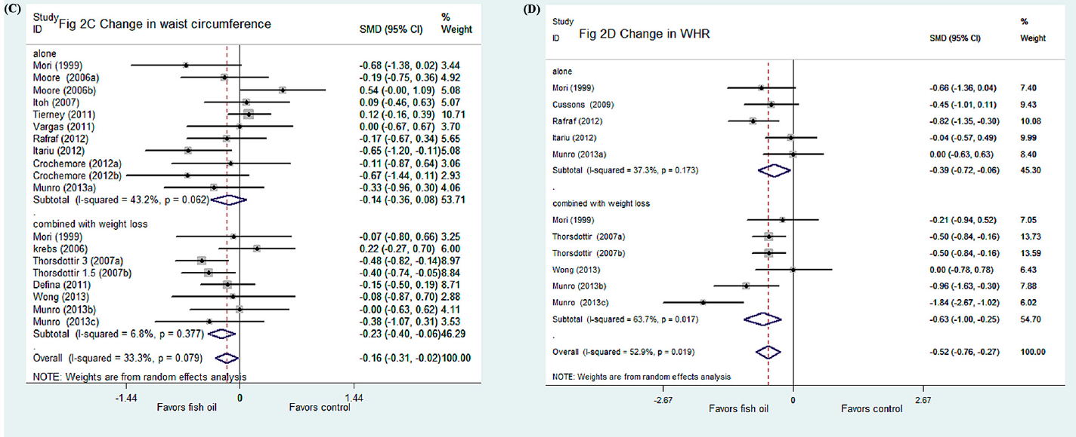
DOES FISH OIL HAVE AN ANTI-OBESITY EFFECT IN OVERWEIGHT/ OBESE ADULTS? A META-ANALYSIS OF RANDOMIZED CONTROLLED TRIALS.
Du S, Jin J, Fang W, Su Q PLoS ONE. 2015; 10(11): e0142652. doi:10.1371/journal.pone.0142652

Slide 23
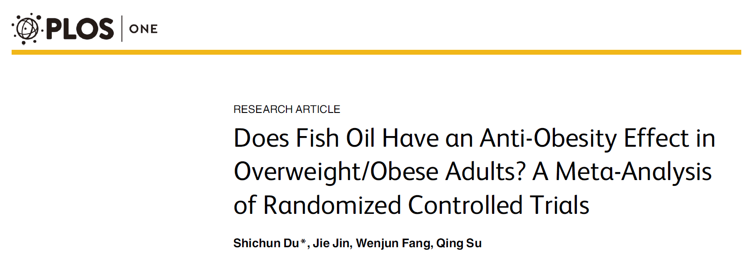
Current evidence cannot support an exact anti-obesity role of n-3 polyunsaturated fatty acids (PUFAs) in overweight/obese subjects.
However, these subjects may benefit from reducing abdominal fat with fish oil supplementation especially when combined with life modification intervention.
Further large-scale and long-term clinical trials are needed to gain definite conclusions.

Slide 24
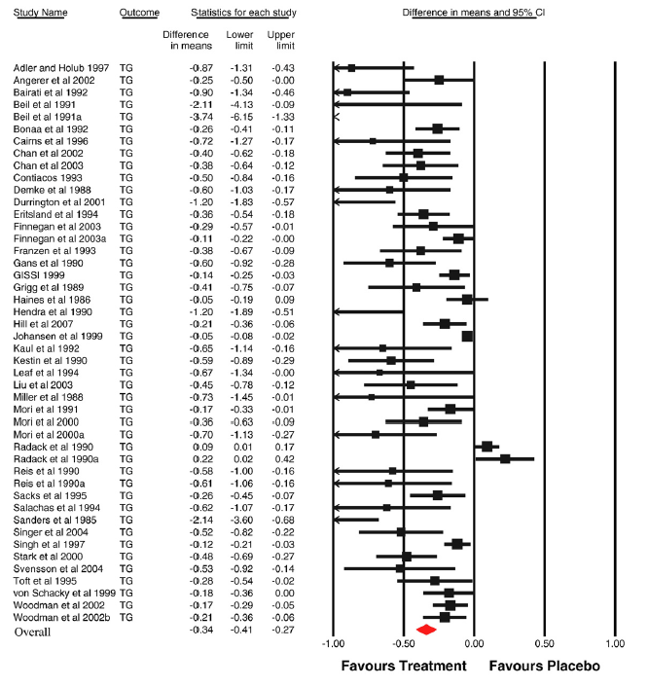
BENEFITS OF FISH OIL SUPPLEMENTATION IN HYPERLIPIDEMIA
Fish oil supplementation produces a clinically significant dose-dependent reduction of fasting blood TG but not total, HDL or LDL cholesterol in hyperlipidemic subjects
Eslick et al. Intern J Cardiol 2009; 136: 4–16

Slide 25
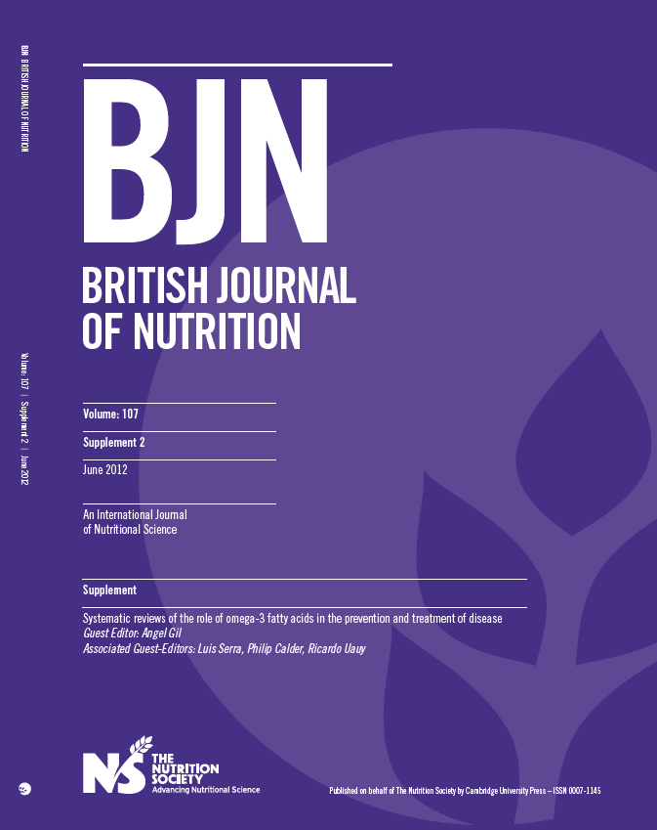

Slide 26
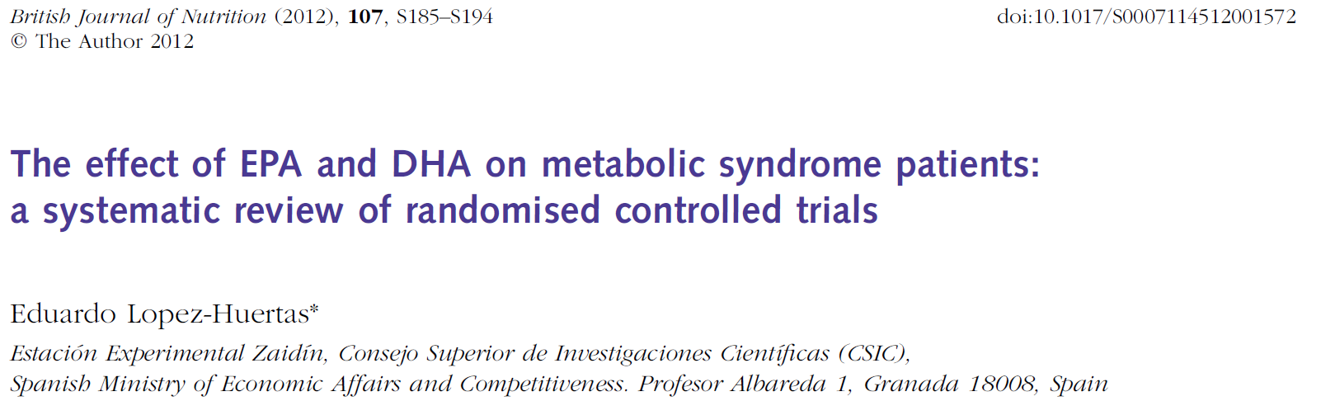
The available 17 RCT convincingly show that the administration of LC n3 PUFA doses > 1 g for at least 3 months produces a significant reduction of plasma triglycerides ranging from 7% to 25%. This reduction may produce further benefits by reducing the % of pro-atherogenic small dense LDL particles (sdLDL) and also perhaps by ameliorating the inflammatory process associated with MS.
High doses of LC n3 PUFA (≥3g/day) may produce further TAG reductions but could raise other risk factors such as LDL-C.
No clear effects were found on total cholesterol, HDL-cholesterol, blood pressure or glycemic control.

Slide 27
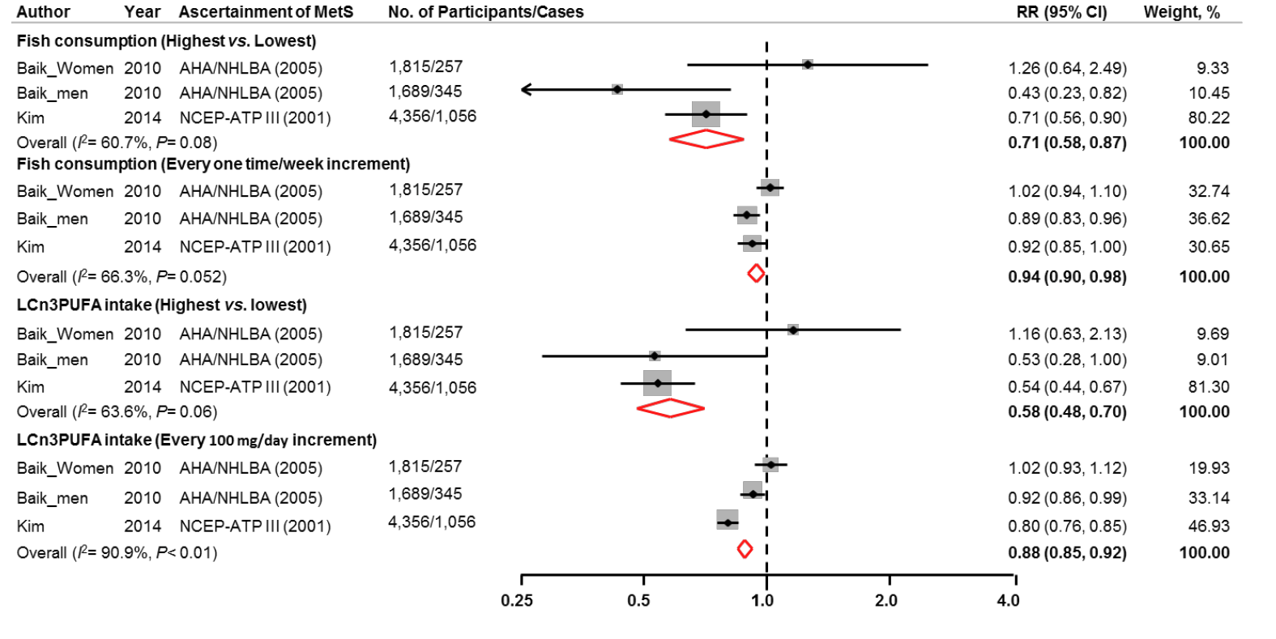
FISH CONSUMPTION, LONG-CHAIN OMEGA-3 POLYUNSATURATED FATTY ACID INTAKE AND RISK OF METABOLIC SYNDROME
Incidence of metabolic syndrome from prospective cohort studies
Kim et al., Nutrients 2015, 7, 2085-2100

Slide 28
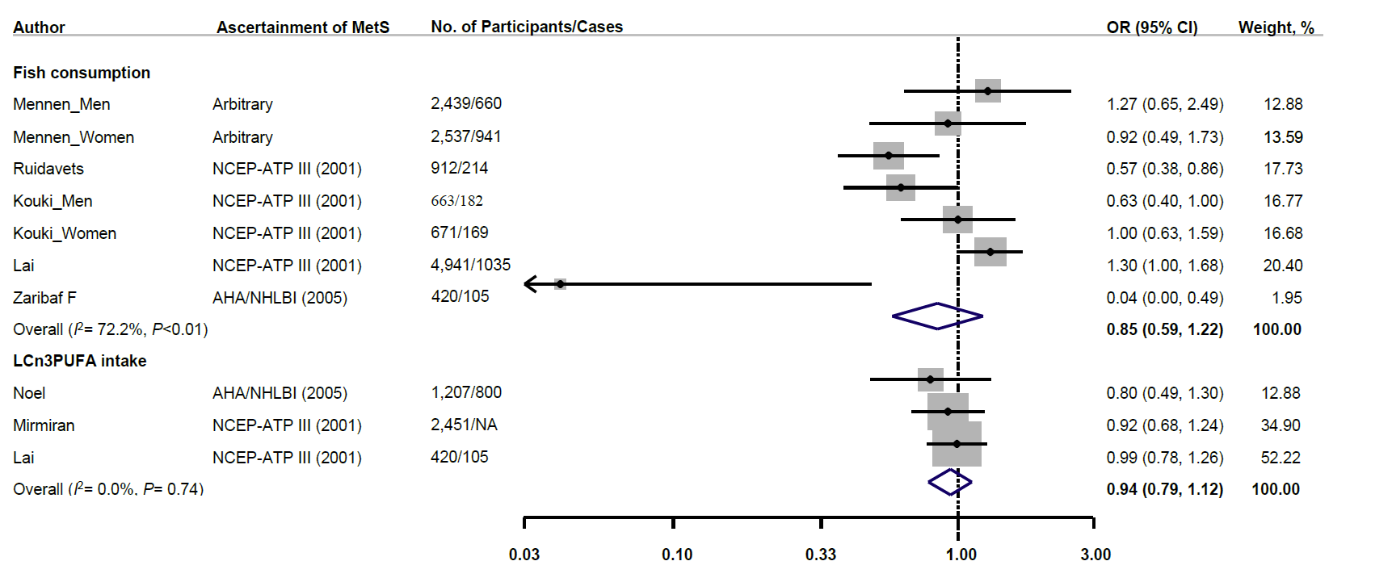
FISH CONSUMPTION, LONG-CHAIN OMEGA-3 POLYUNSATURATED FATTY ACID INTAKE AND RISK OF METABOLIC SYNDROME
Prevalence of metabolic syndrome from cross-sectional studies
A modest inverse association between fish consumption or n-3 LC-PUFA intake and risk of MetS has been observed when combining available data from prospective cohort studies, but not the cross-sectional studies.
Kim et al., Nutrients 2015, 7, 2085-2100

Slide 29
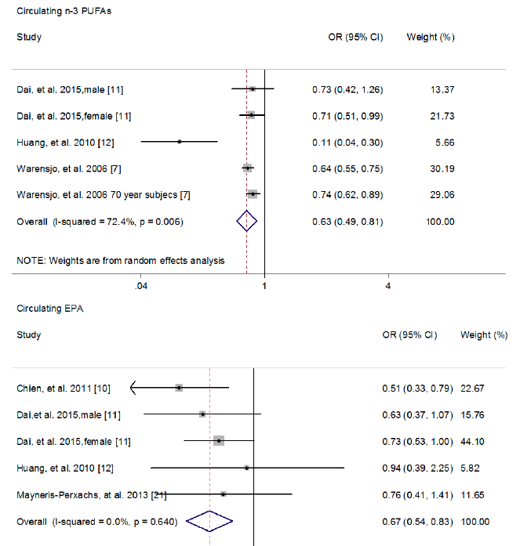
ASSOCIATION OF CIRCULATING N-3 PUFAS OR EPA WITH METABOLIC
SYNDROME RISK
The present study provides substantial evidence of a higher circulating n-3 PUFAs associated with a lower MetS risk
Guo et al. Nutrients 2017, 9, 703; doi:10.3390/nu9070703

Slide 30
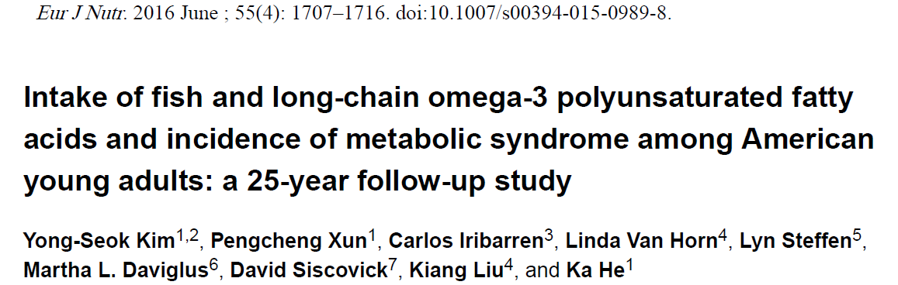
4356 American young adults, free from MetS and diabetes at baseline, prospectively followed for 25 yrs for incident MetS and its components in relation to fish and n-3 LC-PUFA intake
Intakes of n-3 LC-PUFAs and non-fried fish in young adulthood are inversely associated with the incidence of MetS later in life.

Slide 31
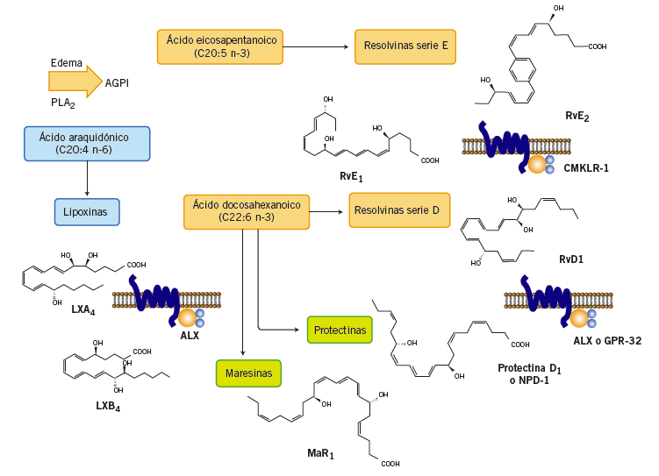
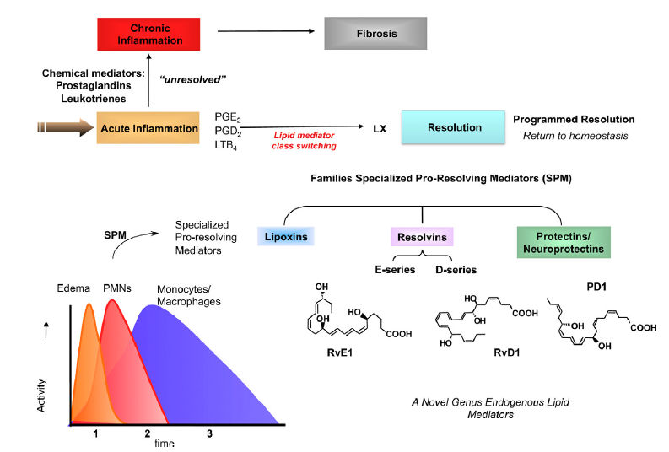
NOVEL MEDIATORS OF INFLAMMATION RESOLUTION DERIVED FROM
n-3 LC-PUFAS
Serhan CN. The American Journal of Pathology, Vol. 177, No. 4, October 2010

Slide 32
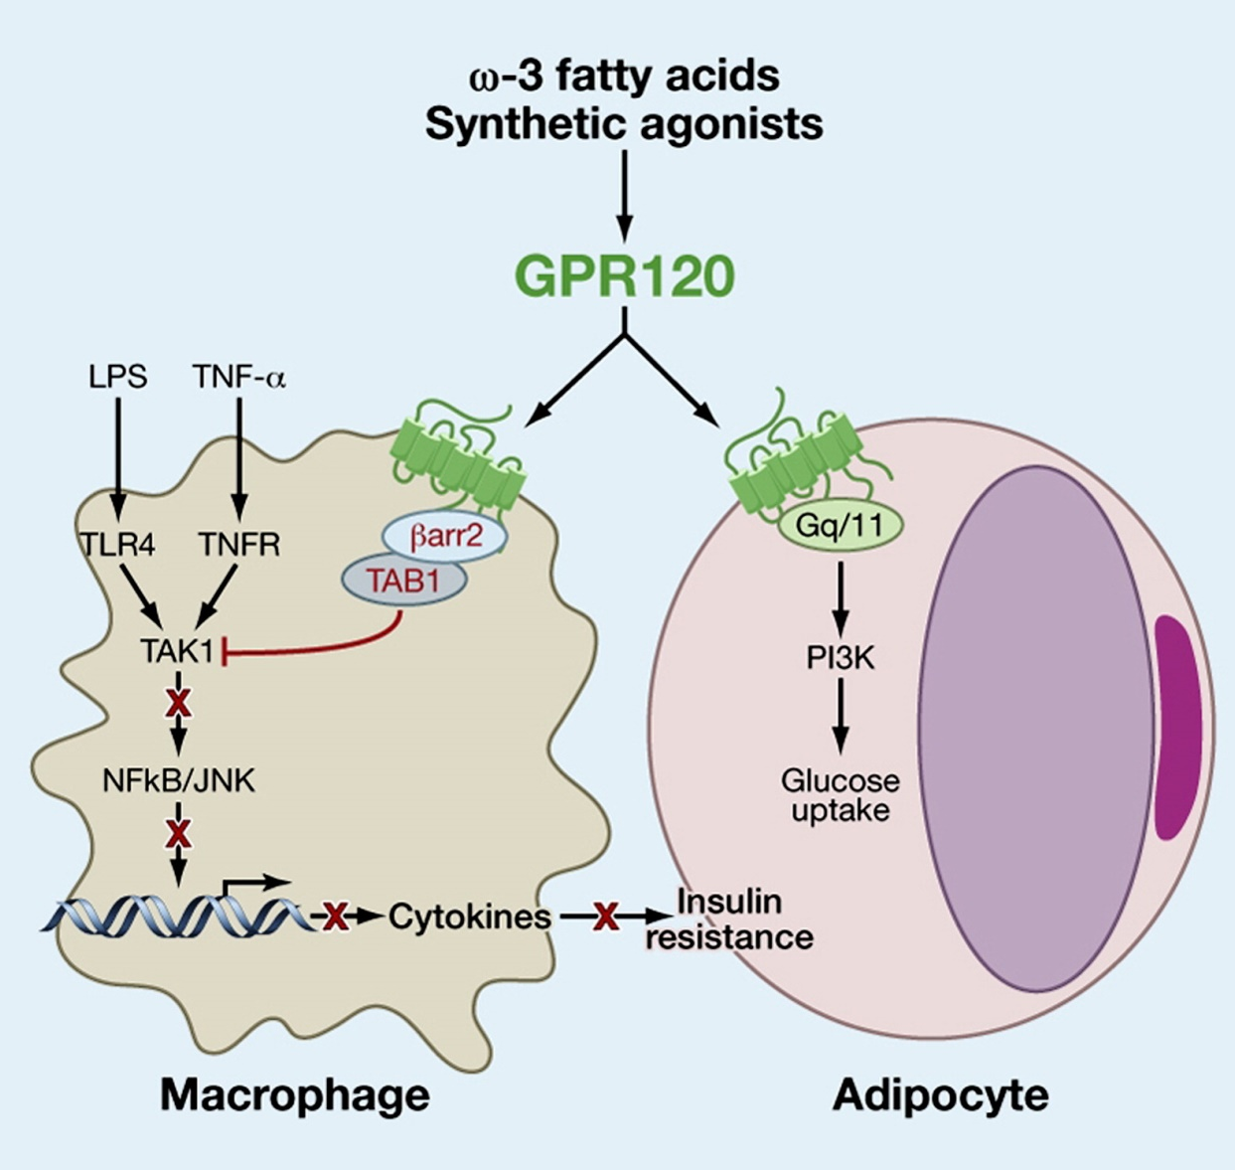
GPR120 IS AN OMEGA-3 FATTY ACID RECEPTOR MEDIATING POTENT ANTI-INFLAMMATORY AND INSULIN-SENSITIZING EFFECTS
Oh DA et al. Cell 2010;142: 687–698

Slide 33
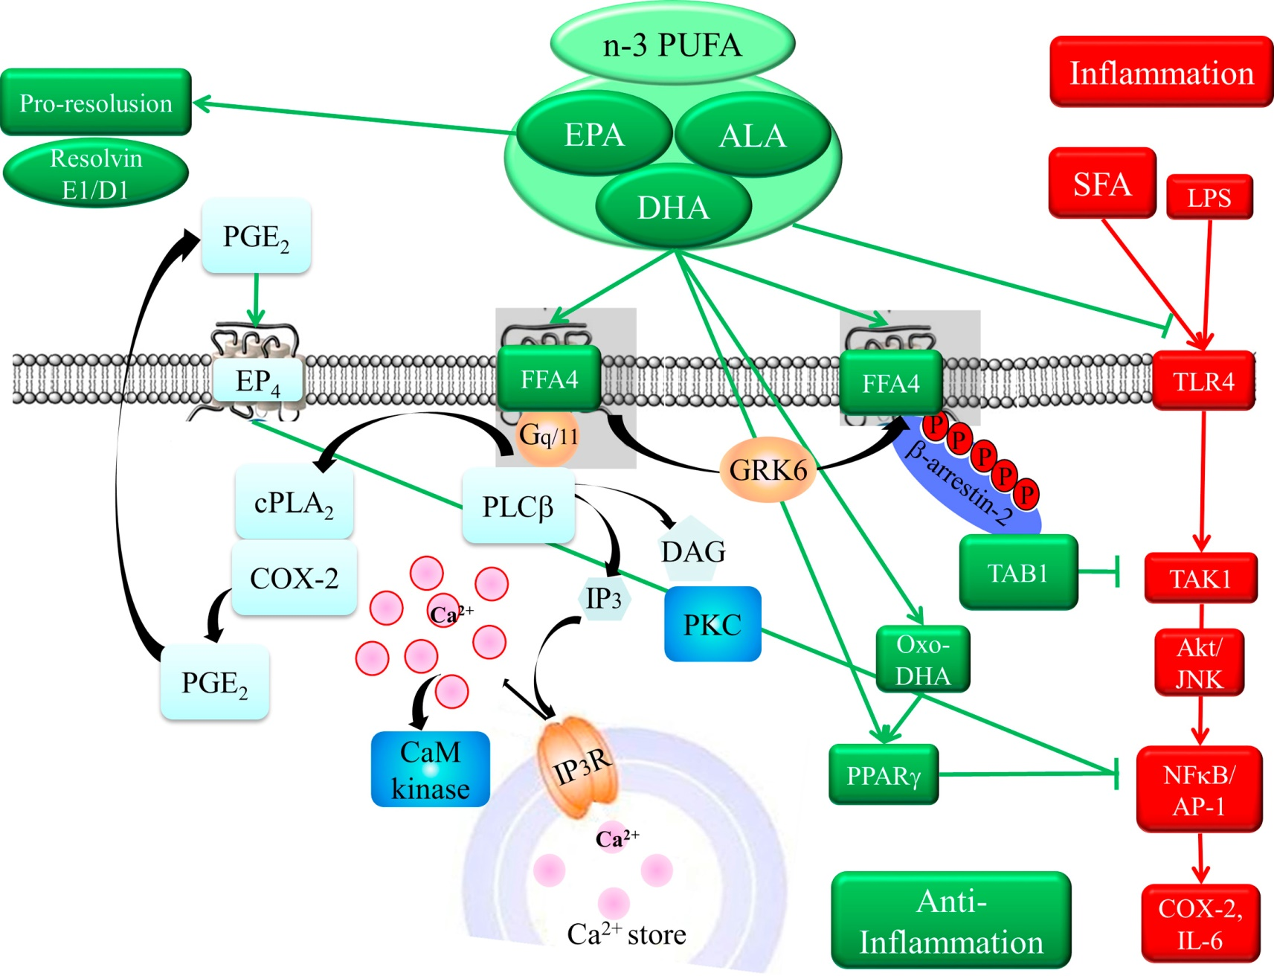
Functions of omega-3 fatty acids and FFA4 (GPR120) in macrophages
Im DG. Eur J Pharmacol 2016; 785: 36–43

Slide 34
MESSAGES TO TAKE HOME
Fish consumption has no appreciable association with body-weight gain. Hence it does not contribute to overweight or obesity
Fish consumption may moderately contribute to reduce body weight, body mass index and waist circumference, but is does not modify fat mass and lean body mass. However, current evidence cannot support an exact anti-obesity role of n-3 polyunsaturated fatty acids (PUFAs) in overweight/obese subjects.
Fish consumption and n-3 LC-PUFA supplementation produces a reduction of fasting blood TG but not total, HDL or LDL cholesterol in hyperlipidemic subjects.
A modest inverse association between fish consumption or n-3 LC-PUFA intake and risk of MetS, a well known comorbidity of obesity, has been observed when combining available data from prospective cohort studies, but not the cross-sectional studies
The anti-inflammatory actions of n-3 LC-PUFA seem to play a key role in the preventive action of fish against obesity and metabolic syndrome

Slide 35

MANY THANKS

